Slide 1
Getting the word out about your eBooks & audiobooks
© OverDrive, Inc. All Rights Reserved.

Slide 2
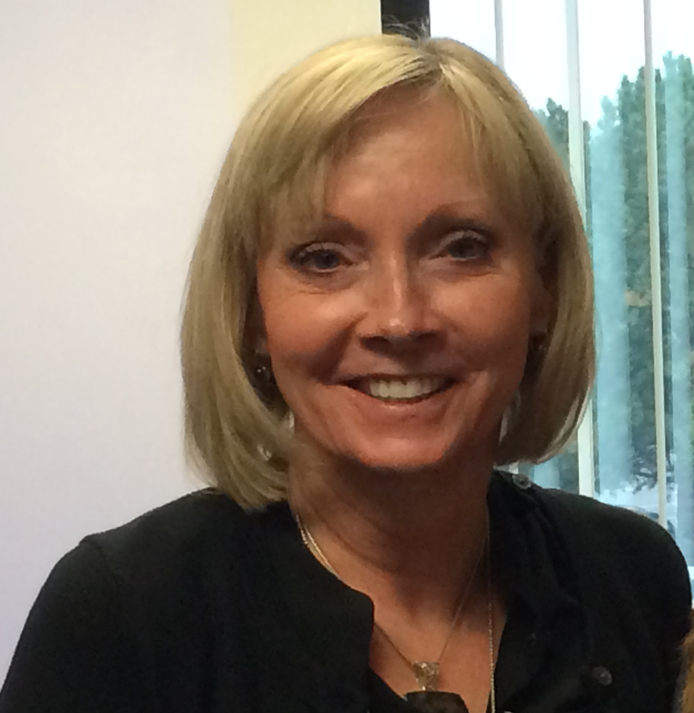
Welcome!
Cindy Moyle
Library Media Specialist
Granite School District (UT)

Slide 3
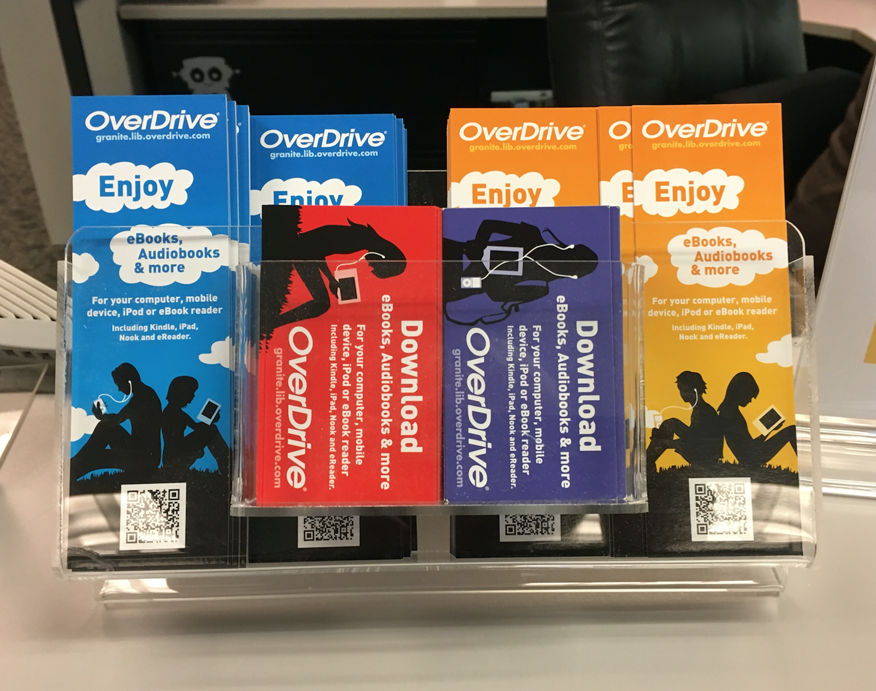
Promote Around School
Bookmarks
Business Cards
QR Code Stickers
http://granitemedia.org

Slide 4
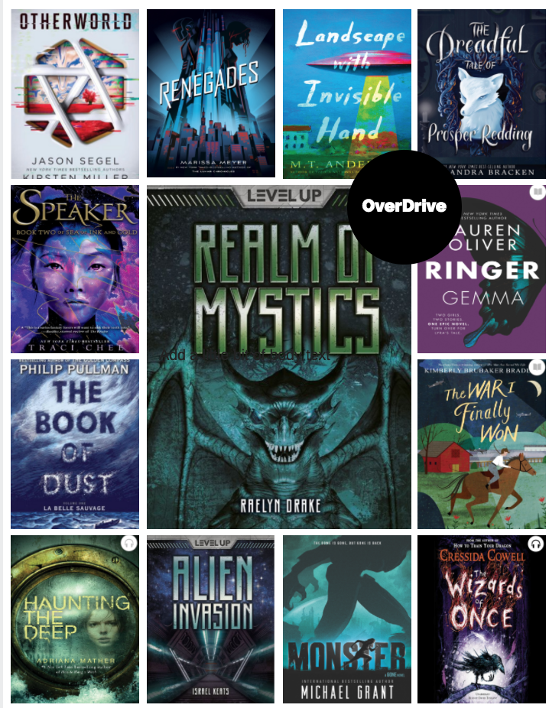
Poster Advertisements
Posters created on:
www.Canva.com

Slide 5
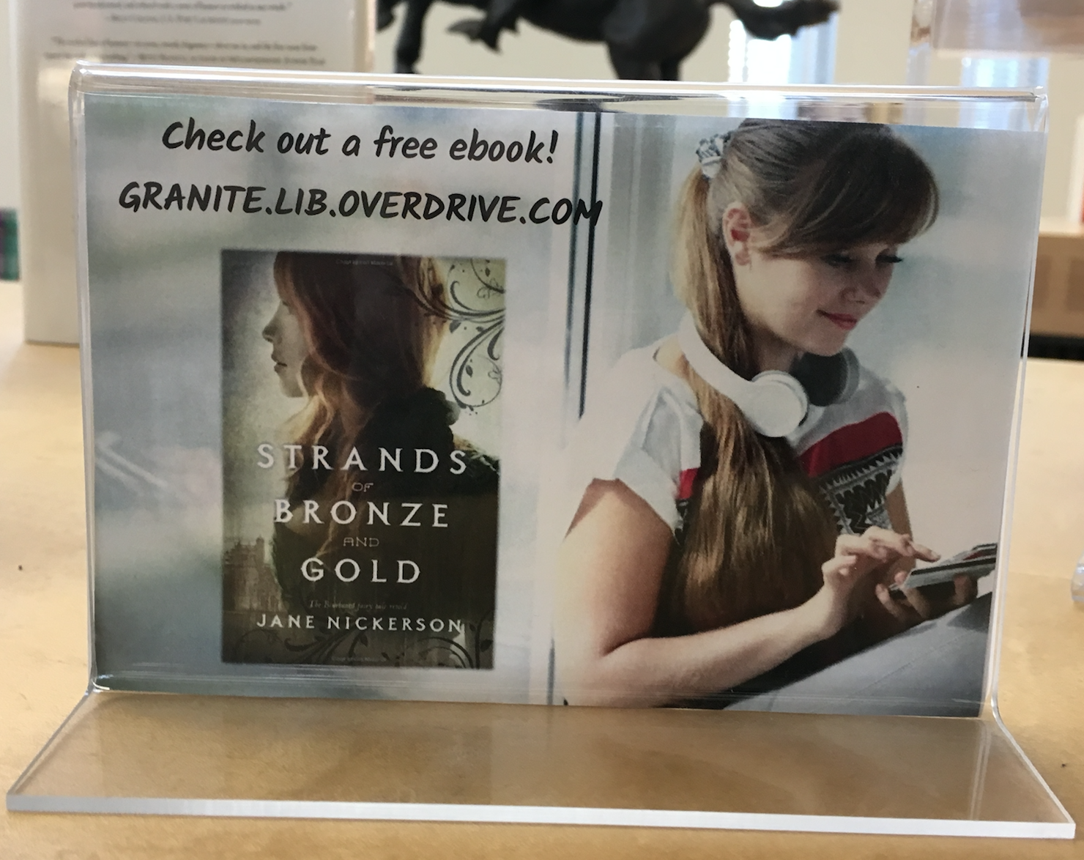
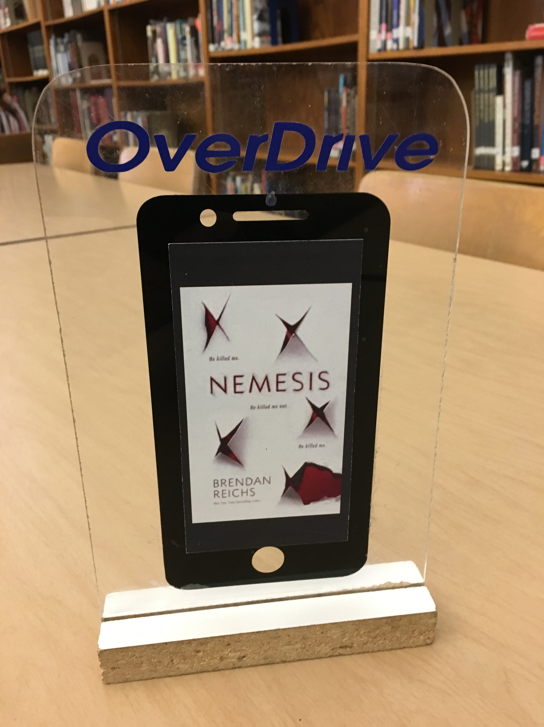
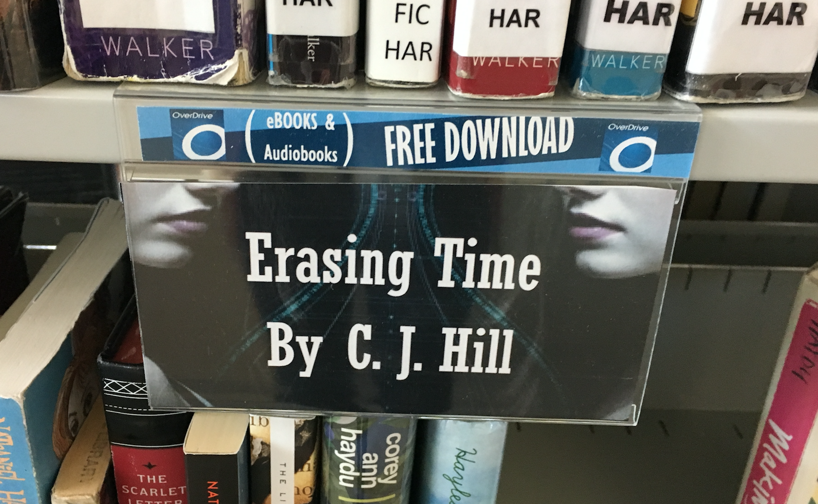
Promote around school
Signage
Shelf Talkers

Slide 6
Promote Big Read

Slide 7
Summer Read Program
The OverDrive Summer Read program offers free, simultaneous access
To digital titles from June to August.
Canvas makes this information available to Granites teachers, students and parents.

Slide 8
Summer Read Displays

Slide 9
School Displays

Slide 10
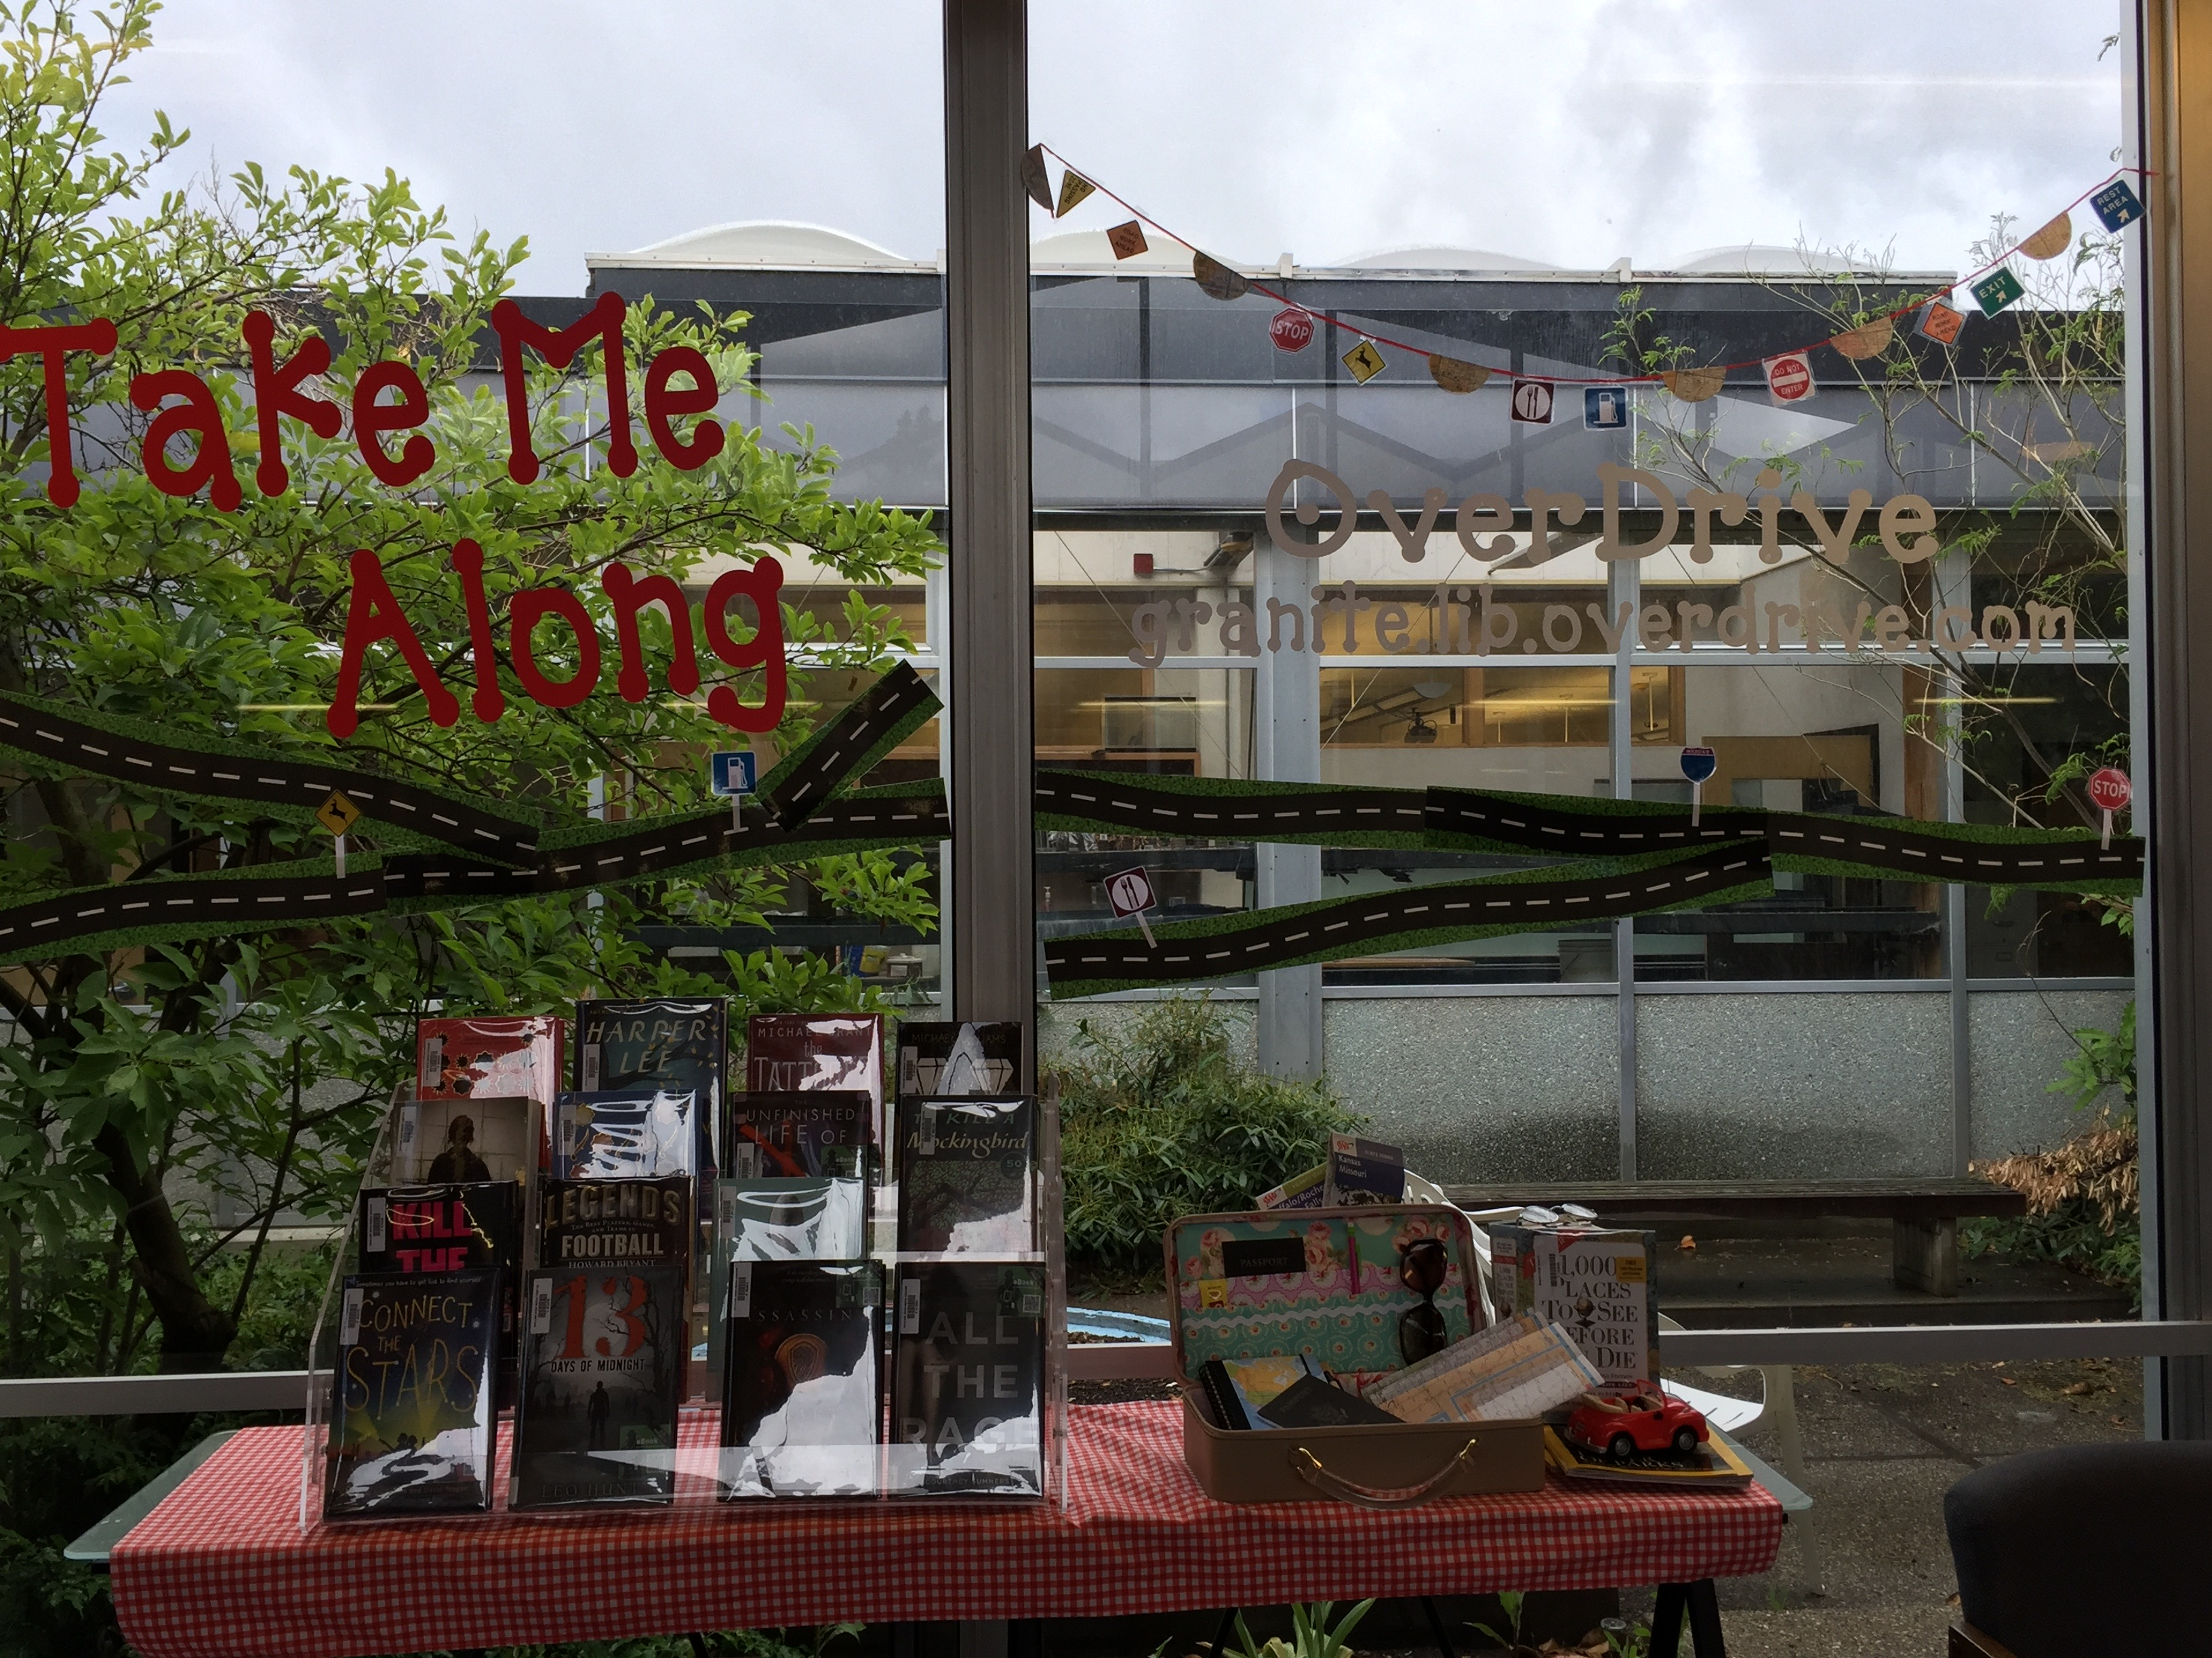
School Displays

Slide 11
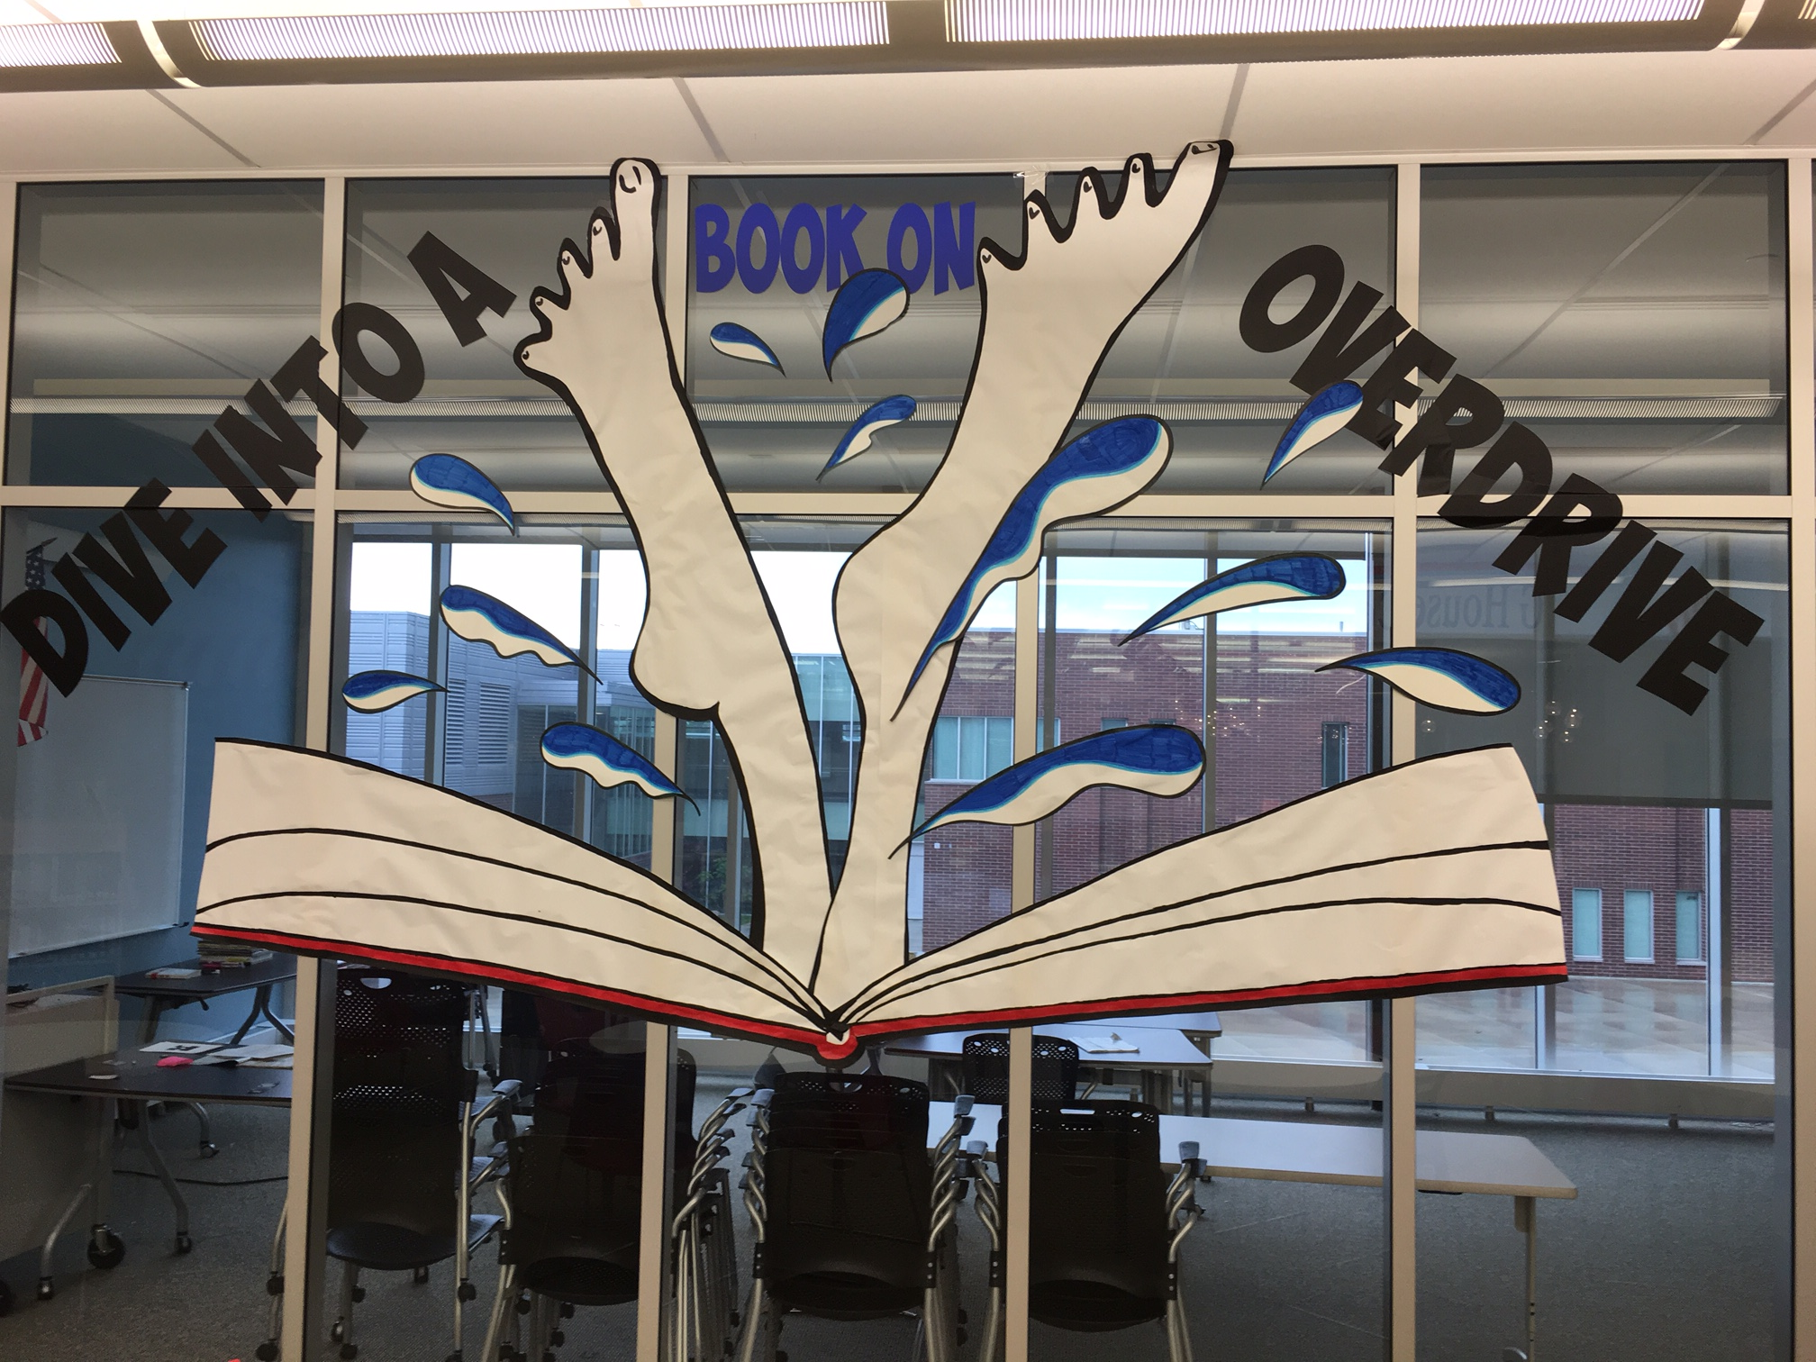
School Displays
School Displays

Slide 12
School Displays – Connecting Print to Digital

Slide 13
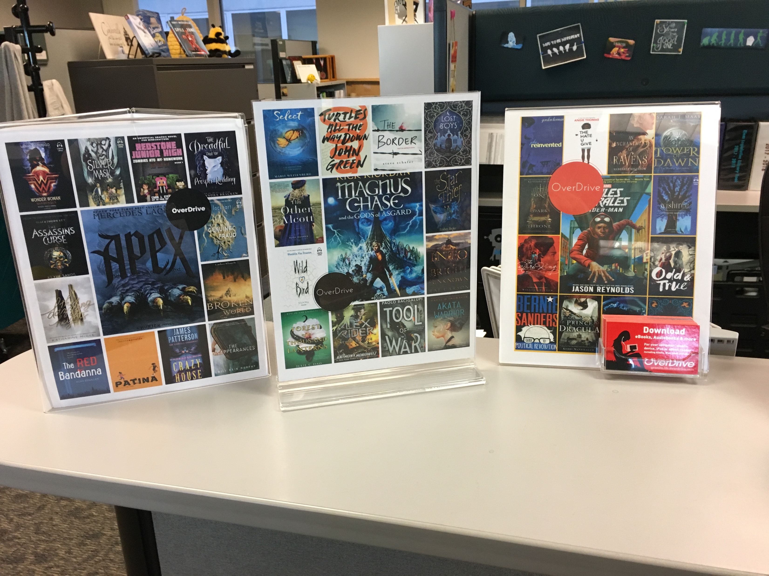
Displays
Monthly Displays

Slide 14
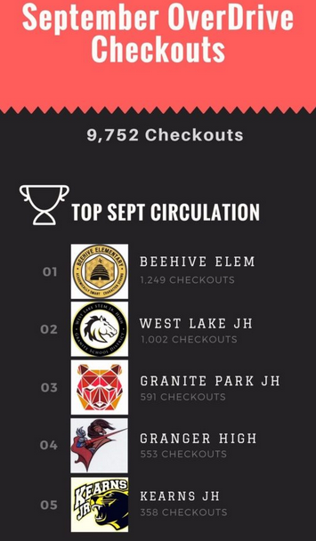
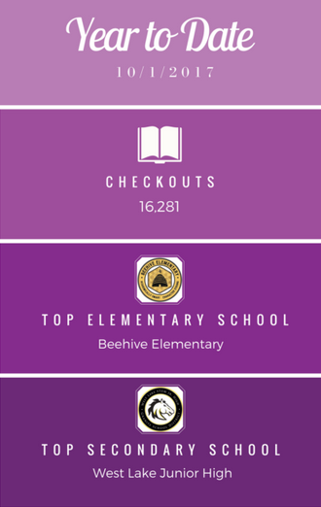
Friendly competition
We award trophies to top-performing schools every month to encourage usage of the digital library – and it’s worked!
2016-2017
68,000 students
92,000 checkout
https://sites.google.com/granitesd.org/overdrive-circulation-granite/home?authuser=1

Slide 15
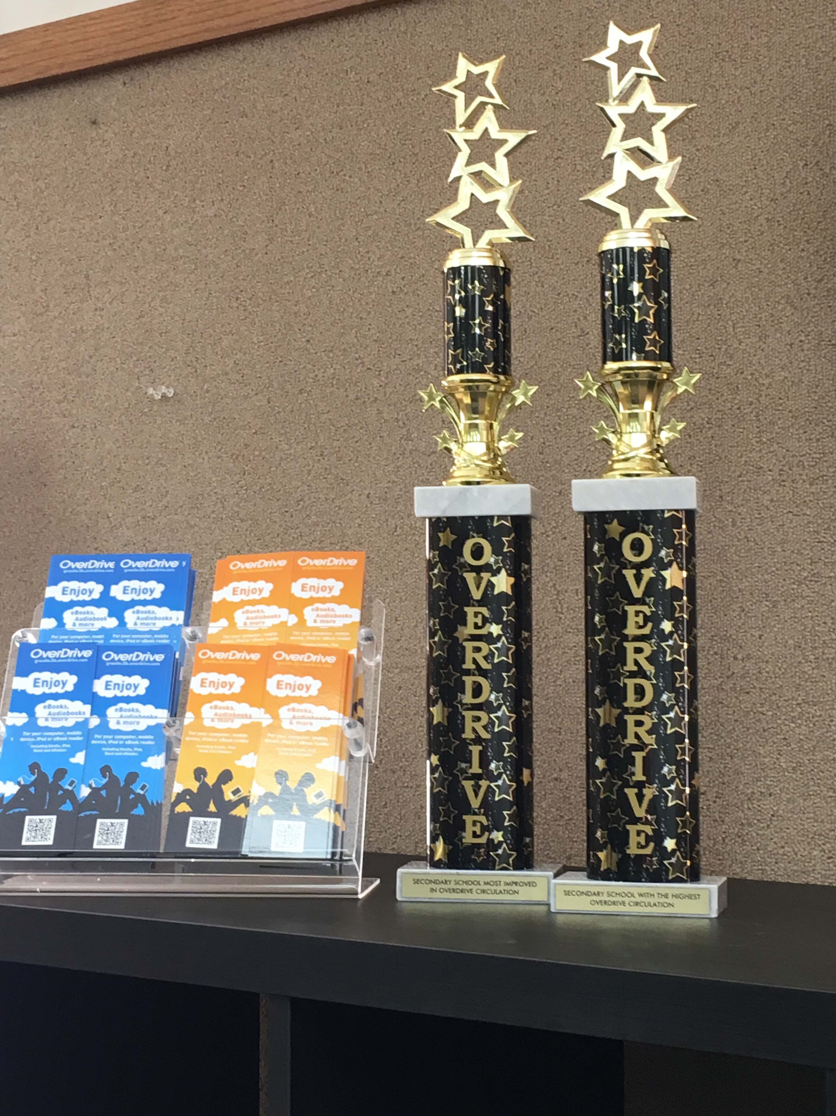
Top Circulation
Traveling Trophies
Top Circulation
Most Improved

Slide 16
Most Improved

Slide 17
Special Collections – District Battle of the Books
We created Special Collections for book clubs, Utah Book Awards and school promotions.

Slide 18
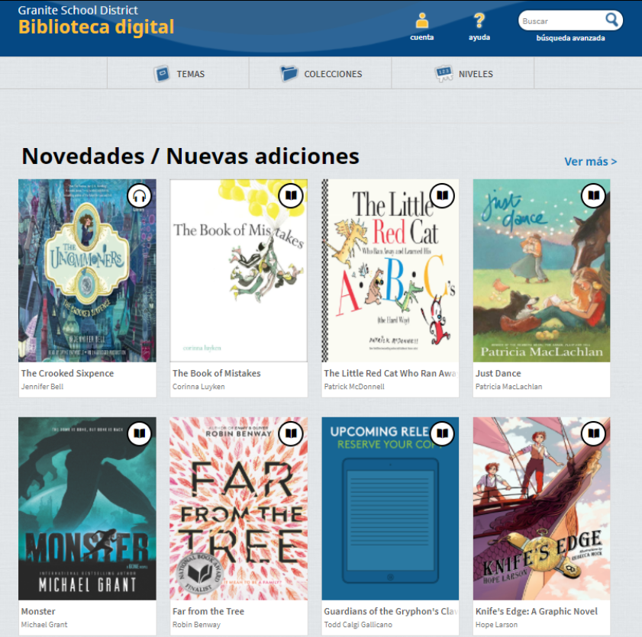
Special Collections -- Languages
We use the multilingual interface option to allow our digital collection to be navigated in Spanish
We have added a collection of Spanish titles as well.

Slide 19
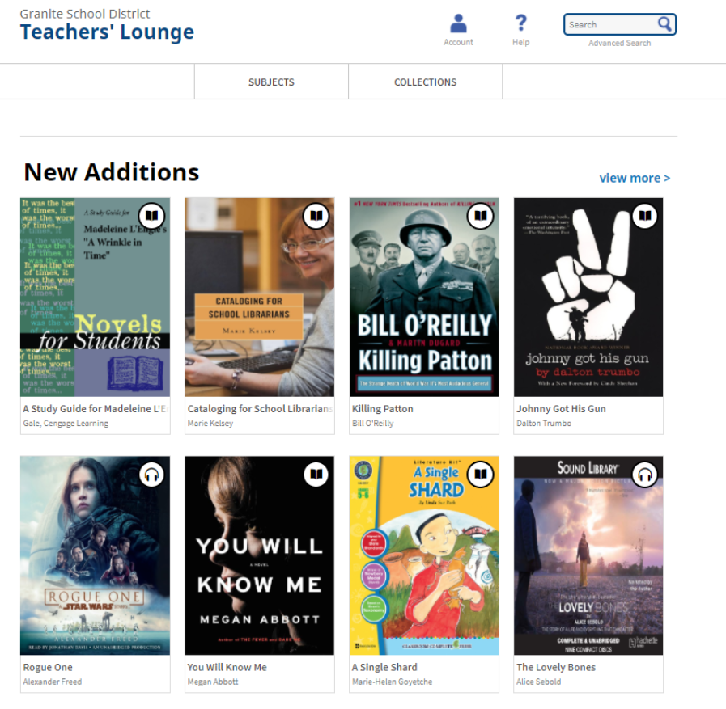
Special Collections – Teachers’ Lounge
The Teachers’ Lounge is a dedicated space within the digital collection focused on our teachers’ reading needs

Slide 20
Get students involved in collection development
The Recommend to Library feature allows students to request titles to be added to our digital collection
This gives them a sense of ownership and ensures we’re offering the right titles

Slide 21
Overdrive Success

Slide 22
Questions?

