Slide 1
TOP TITLES OF 2021
GRANITE SCHOOL LIBRARIES
SR. HIGH

Slide 2
Fiction
TOP TITLES OF 2021
GRANITE SCHOOL LIBRARIES * SR. HIGH
Most popular titles published in 2020 or 2021 based on library checkouts.
Visit toptitles.granitemedia.org for more information.

Slide 3
Fiction
TOP TITLES OF 2021
GRANITE SCHOOL LIBRARIES * SR. HIGH
Most popular titles published in 2020 or 2021 based on library checkouts.
Visit toptitles.granitemedia.org for more information.

Slide 4
Fiction
TOP TITLES OF 2021
GRANITE SCHOOL LIBRARIES * SR. HIGH
Most popular titles published in 2020 or 2021 based on library checkouts.
Visit toptitles.granitemedia.org for more information.

Slide 5
Nonfiction
TOP TITLES OF 2021
GRANITE SCHOOL LIBRARIES * SR. HIGH
Most popular titles published in 2020 or 2021 based on library checkouts.
Visit toptitles.granitemedia.org for more information.

Slide 6
Nonfiction
TOP TITLES OF 2021
GRANITE SCHOOL LIBRARIES * SR. HIGH
Most popular titles published in 2020 or 2021 based on library checkouts.
Visit toptitles.granitemedia.org for more information.

Slide 7
Graphic Novels
TOP TITLES OF 2021
GRANITE SCHOOL LIBRARIES * SR. HIGH
Most popular titles published in 2020 or 2021 based on library checkouts.
Visit toptitles.granitemedia.org for more information.

Slide 8
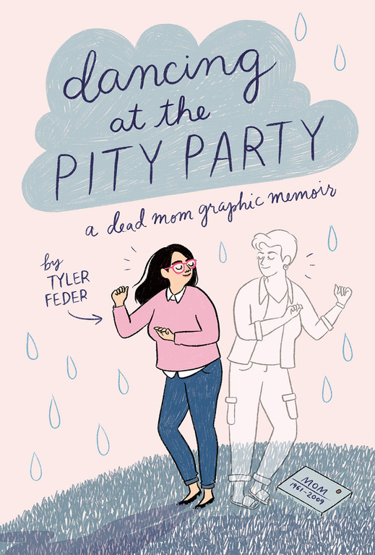
Graphic Novels
TOP TITLES OF 2021
GRANITE SCHOOL LIBRARIES * SR. HIGH
Most popular titles published in 2020 or 2021 based on library checkouts.
Visit toptitles.granitemedia.org for more information.

