Slide 1
TOP TITLES OF 2022
GRANITE SCHOOL LIBRARIES
ELEMENTARY

Slide 2
Picture Books & Easy
TOP TITLES OF 2022
GRANITE SCHOOL LIBRARIES * ELEMENTARY
Most popular titles published in 2022 based on library checkouts.
Visit toptitles.granitemedia.org for more information.

Slide 3
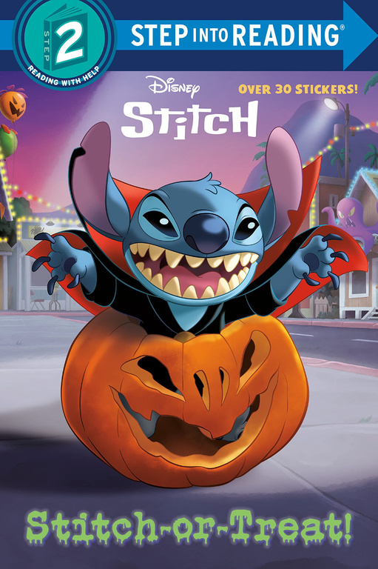
Picture Books & Easy
TOP TITLES OF 2022
GRANITE SCHOOL LIBRARIES * ELEMENTARY
Most popular titles published in 2022 based on library checkouts.
Visit toptitles.granitemedia.org for more information.

Slide 4
Picture Books & Easy
TOP TITLES OF 2022
GRANITE SCHOOL LIBRARIES * ELEMENTARY
Most popular titles published in 2022 based on library checkouts.
Visit toptitles.granitemedia.org for more information.

Slide 5
Chapter Books
TOP TITLES OF 2022
GRANITE SCHOOL LIBRARIES * ELEMENTARY
Most popular titles published in 2022 based on library checkouts.
Visit toptitles.granitemedia.org for more information.

Slide 6
Chapter Books
TOP TITLES OF 2022
GRANITE SCHOOL LIBRARIES * ELEMENTARY
Most popular titles published in 2022 based on library checkouts.
Visit toptitles.granitemedia.org for more information.

Slide 7
Fiction
TOP TITLES OF 2022
GRANITE SCHOOL LIBRARIES * ELEMENTARY
Most popular titles published in 2022 based on library checkouts.
Visit toptitles.granitemedia.org for more information.

Slide 8
Fiction
TOP TITLES OF 2022
GRANITE SCHOOL LIBRARIES * ELEMENTARY
Most popular titles published in 2022 based on library checkouts.
Visit toptitles.granitemedia.org for more information.

Slide 9
Fiction
TOP TITLES OF 2022
GRANITE SCHOOL LIBRARIES * ELEMENTARY
Most popular titles published in 2022 based on library checkouts.
Visit toptitles.granitemedia.org for more information.

Slide 10
Nonfiction
TOP TITLES OF 2022
GRANITE SCHOOL LIBRARIES * ELEMENTARY
Most popular titles published in 2022 based on library checkouts.
Visit toptitles.granitemedia.org for more information.

Slide 11
Nonfiction
TOP TITLES OF 2022
GRANITE SCHOOL LIBRARIES * ELEMENTARY
Most popular titles published in 2022 based on library checkouts.
Visit toptitles.granitemedia.org for more information.

Slide 12
Nonfiction
TOP TITLES OF 2022
GRANITE SCHOOL LIBRARIES * ELEMENTARY
Most popular titles published in 2022 based on library checkouts.
Visit toptitles.granitemedia.org for more information.

Slide 13
Graphic Novels
TOP TITLES OF 2022
GRANITE SCHOOL LIBRARIES * ELEMENTARY
Most popular titles published in 2022 based on library checkouts.
Visit toptitles.granitemedia.org for more information.

Slide 14
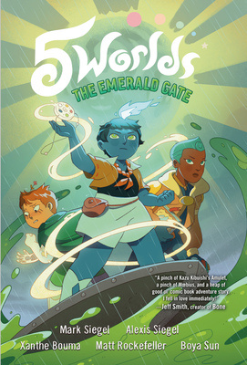
Graphic Novels
TOP TITLES OF 2022
GRANITE SCHOOL LIBRARIES * ELEMENTARY
Most popular titles published in 2022 based on library checkouts.
Visit toptitles.granitemedia.org for more information.

Slide 15
Graphic Novels
TOP TITLES OF 2022
GRANITE SCHOOL LIBRARIES * ELEMENTARY
Most popular titles published in 2022 based on library checkouts.
Visit toptitles.granitemedia.org for more information.

