Slide 1
TOP TITLES OF 2022
GRANITE SCHOOL LIBRARIES
JR. HIGH

Slide 2
Fiction
TOP TITLES OF 2022
GRANITE SCHOOL LIBRARIES * JR. HIGH
Most popular titles published in 2022 based on library checkouts.
Visit toptitles.granitemedia.org for more information.

Slide 3
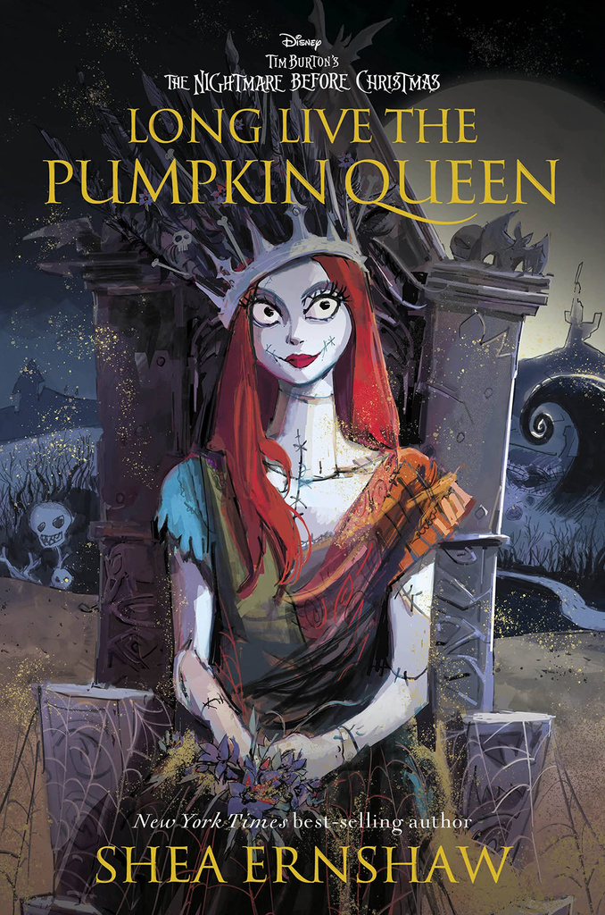
Fiction
TOP TITLES OF 2022
GRANITE SCHOOL LIBRARIES * JR. HIGH
Most popular titles published in 2022 based on library checkouts.
Visit toptitles.granitemedia.org for more information.

Slide 4
Fiction
TOP TITLES OF 2022
GRANITE SCHOOL LIBRARIES * JR. HIGH
Most popular titles published in 2022 based on library checkouts.
Visit toptitles.granitemedia.org for more information.

Slide 5
Nonfiction
TOP TITLES OF 2022
GRANITE SCHOOL LIBRARIES * JR. HIGH
Most popular titles published in 2022 based on library checkouts.
Visit toptitles.granitemedia.org for more information.

Slide 6
Nonfiction
TOP TITLES OF 2022
GRANITE SCHOOL LIBRARIES * JR. HIGH
Most popular titles published in 2022 based on library checkouts.
Visit toptitles.granitemedia.org for more information.

Slide 7
Graphic Novels
TOP TITLES OF 2022
GRANITE SCHOOL LIBRARIES * JR. HIGH
Most popular titles published in 2022 based on library checkouts.
Visit toptitles.granitemedia.org for more information.

Slide 8
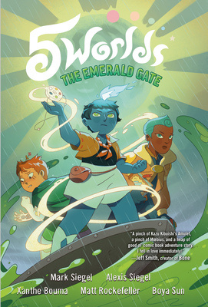
Graphic Novels
TOP TITLES OF 2022
GRANITE SCHOOL LIBRARIES * JR. HIGH
Most popular titles published in 2022 based on library checkouts.
Visit toptitles.granitemedia.org for more information.

Slide 9
Graphic Novels
TOP TITLES OF 2022
GRANITE SCHOOL LIBRARIES * JR. HIGH
Most popular titles published in 2022 based on library checkouts.
Visit toptitles.granitemedia.org for more information.

